Slide 1
CSS 422 Hardware and Computer Organization
Bus and I/O
Ver. 2
Professor: Munehiro Fukuda

Slide 2
Topics
Bus Organization
Bus arbitration and tri states
Memory-Mapped versus Port-Mapped I/O
Intel and ARM examples
Interrupt Handling
Assembly programs to handle interrupts
Direct Memory Access
Pros and cons of direct memory access

Slide 3
Bus Organization
How do we manage the
flow of information?

Slide 4
Bus Collision
Busses were invented in order to simplify the organization and flow of data within computer systems
Busses allow many devices to connect to the same data path
Allow for efficient exchange of data between devices
Question: How do I connect outputs together and not get a short circuit?
BUS
1
AND
Gate 1
1 (5V)
0 (0V)
AND
Gate 2
1
1
0
Short circuit ( bus contention)
Actual result will be an indeterminate logic level

Slide 5
Bus Arbitration
Input(s) d,e,f
Logical
Function
2
Connected to bus
Bus
Interface
Input(s) a,b,c
Logical
Function
1
Isolated from bus
Bus control
Close the switch > output connected
Open the switch > output disconnected
BUS

Slide 6
Bus Interface Structure: Tristate
Output Enable INPUT OUTPUT
Truth table for Bus Interface Gate
0
1
1
0
0
0
1
1
Hi Z
1
0
Hi Z
Bus Interface Gate
Hi Z: removing the gate
from the circuit
INPUT
1 or 0
1 or 0 or HiZ
Logic
Gate
OUTPUT
Output
Enable

Slide 7
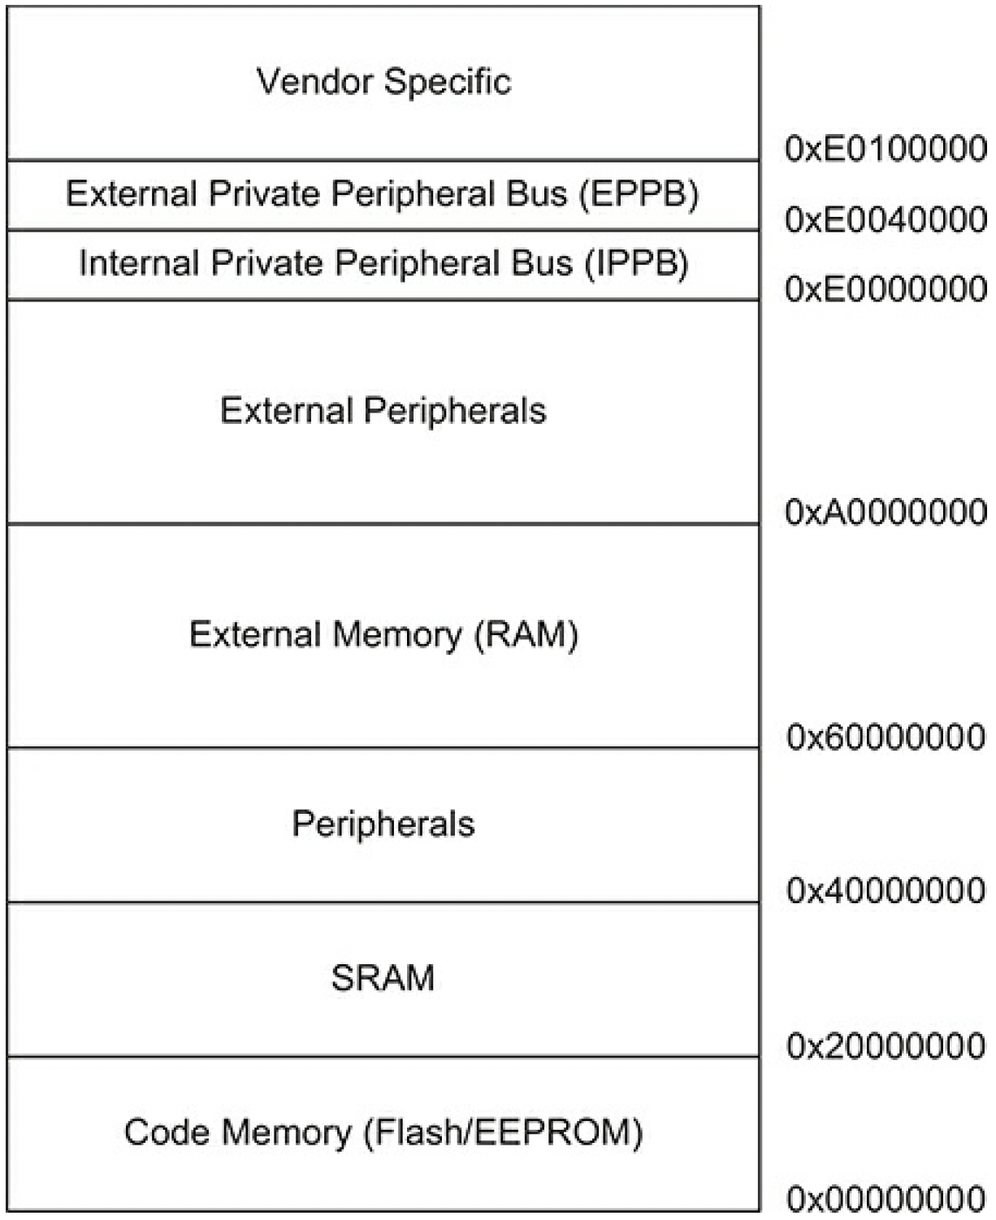
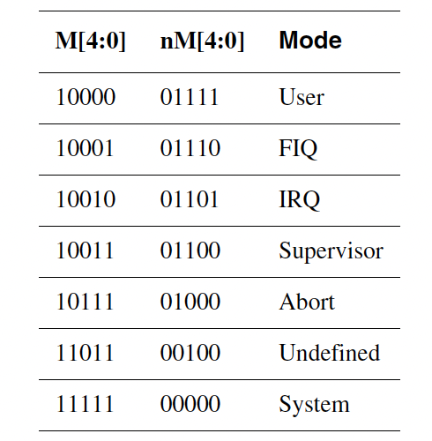
Memory-Mapped I/O
I/O ports are mapped on the memory address space.
Processor
Easy implementation
Address decoding
More complicated
nWAIT used for slow I/O devices
OS viewpoint
Can’t cause a trap when a user program accesses I/O ports.
Yet reserve I/O ports for OS accesses, using M[4:0]
CPU
D0-D31
A0-A31

Slide 8
Port-Mapped I/O
I/O ports have a seprate space from the memory address space.
Processor
Distinguishes MOVE and IN/OUT.
Needs a pin such as IO/~M
Address decoding
Easy
OS viewpoint
Can cause a trap when a user program executes IN and OUT.
CPU
D0-D31
I/O Bridge
Mem
A0-A31
IO
#00000000
Memory
Space
#FFFFFFFF
#00000000
I/O
Port
#FFFFFFFF
#00008000
Actual Devices
#00009FFF
D0-D15

Slide 9
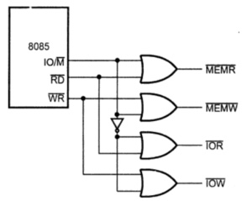
Switching b/w Memory and I/O Address Spaces
IO/~M distinguishes memory and I/O address spaces.
~RD and ~WR are shared among system memory and I/O advices
From Microprocessors and Microcontroler 1-15 8085 Microprocessor Architecture

Slide 10
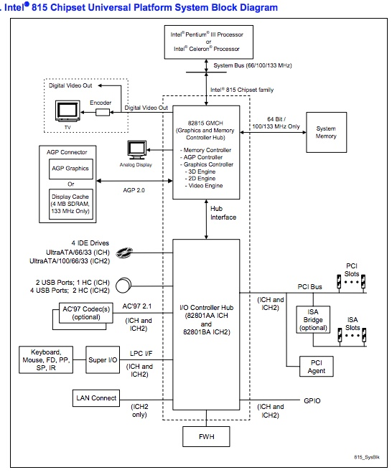
Intel Port-Mapped I/O
System bus and I/O buses are separated by GMCH (Graphics and Memory Controller Hub) and I/O Controller Hub.
Fast system memory versus slow I/O devices
64-bit memory address space versus 32-bit I/O port space
From Intel 815 Chipset Family Datasheet

Slide 11
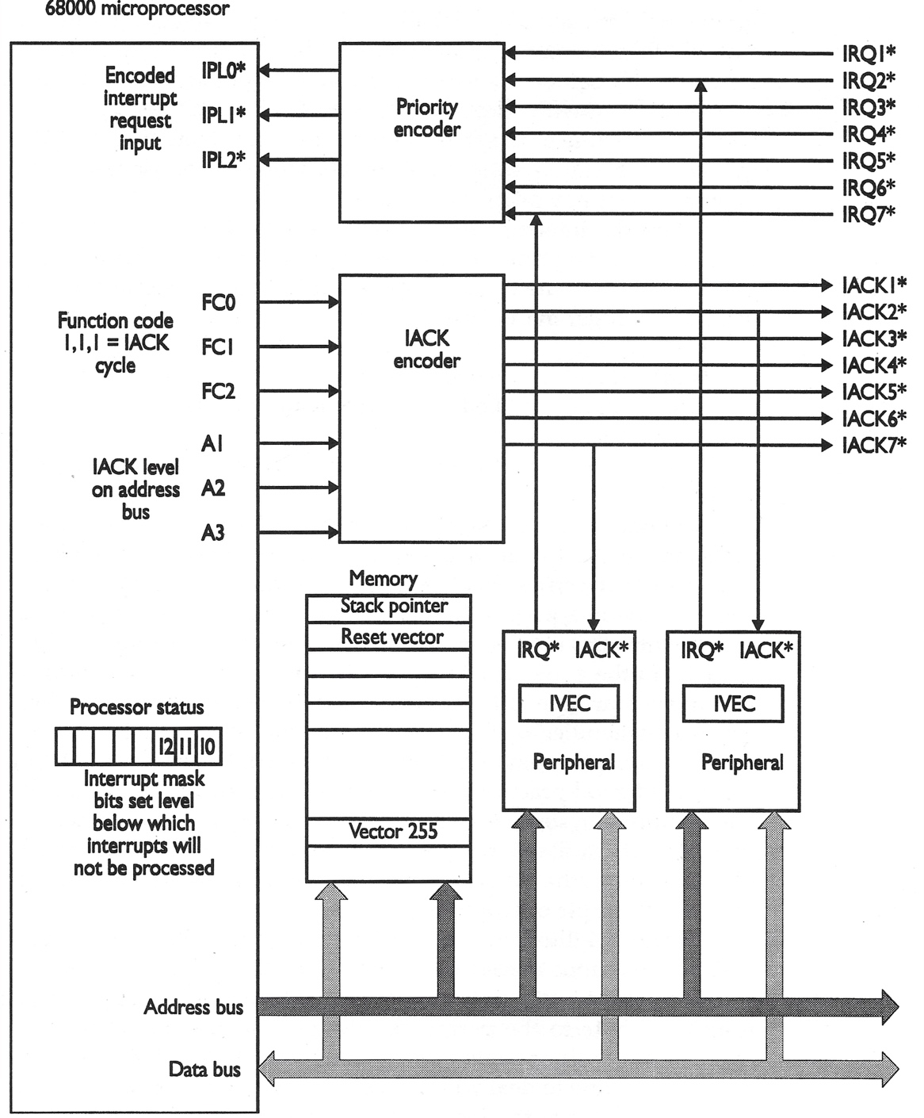
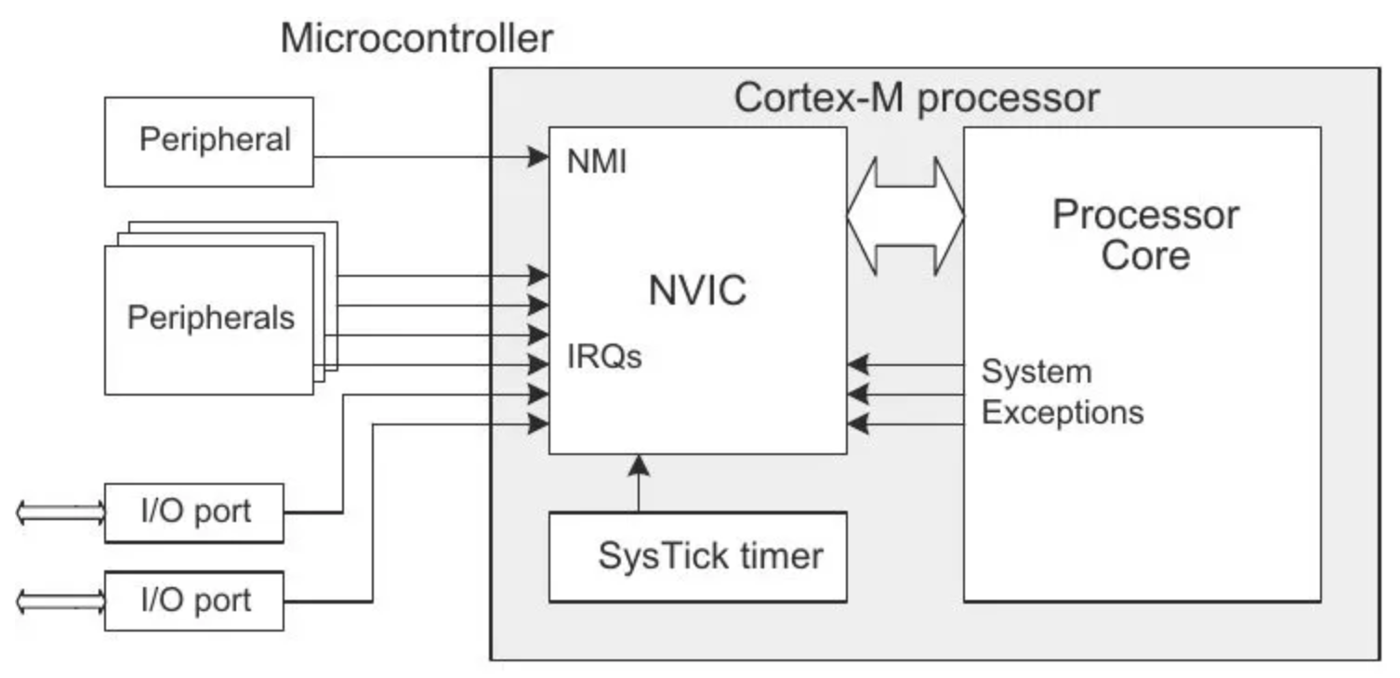
68K vs ARM Interrupt
Polling versus Interrupt-Driven I/O
Polling: CPU needs to keep checking an I/O port if the corresponding peripheral is ready.
Interrupt: CPU can work on a different task while a peripheral needs time to respond back.
68K interrupt sequence
IRQ asserted by a device
IACK responding back to the device
The device presenting the vector# on the data bus.
CPU pushes the PC/CCR on the stack.
CPU jumps to the corresponding interrupt handling routine.
ARM interrupt sequence
IRQ asserted by a device
CPU pushes R0-R3, R12, LR, PC, xPSR
M[4:0] sent back from CPU to NVIC
CPU jumps to NVIC’s predefined interrupt vector table entry.
Clements: p367
https://microcontrollerslab.com/

Slide 12
CPU’s Interrupt Service
(2)
(1)
Jump to the corresponding vector table entry
GPIOA_Handler\
PROC
EXPORT GPIOA_Handler [WEAK]
STMFD sp!, {lr}
; do something
MRS R1, PSP
STR R0, [R1]
LDMFD sp!, {pc}
ENDP
(4)
(3)

Slide 13
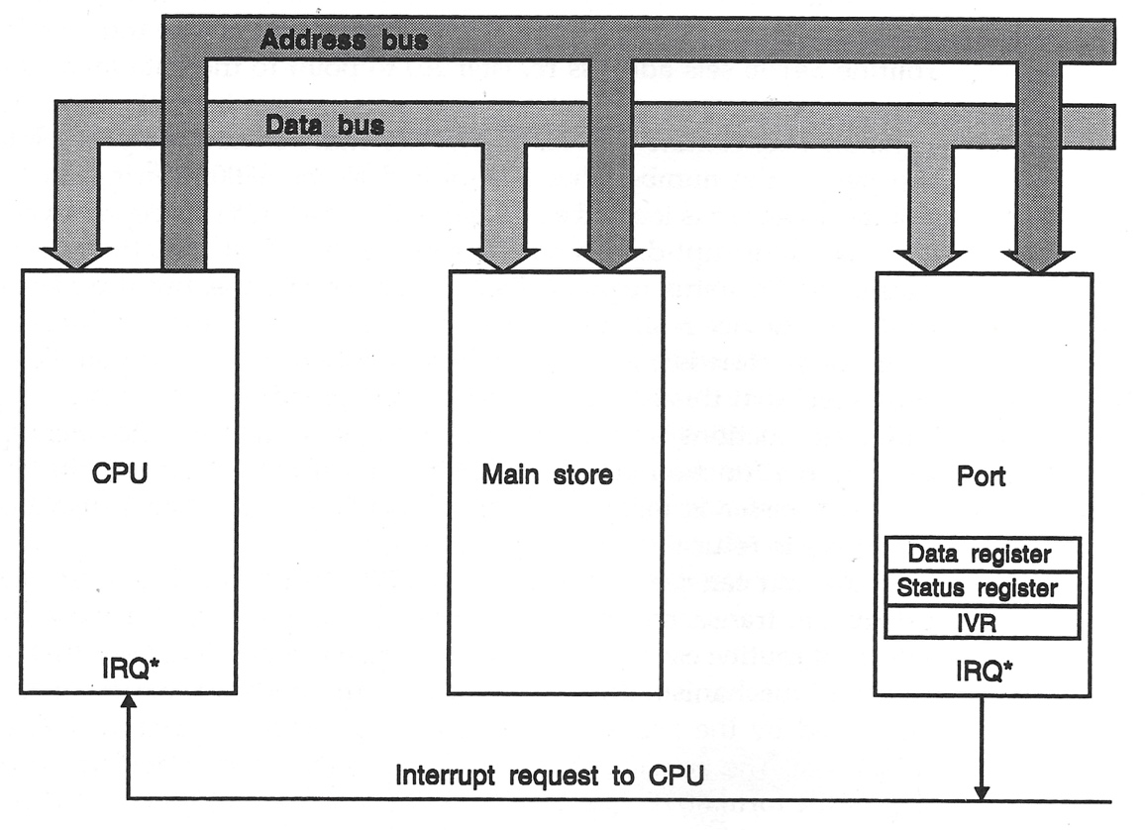
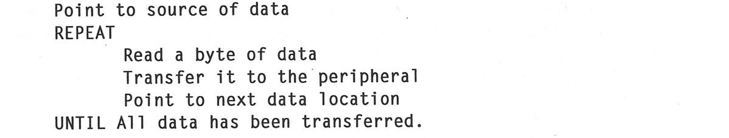
Direct Memory Access (1)
Programmed I/O
Data read into CPU
LDR R0, =#0x20000000
LDR R1, [R0]
Instruction Fetch * 2
Read (0x20000000)
Data written from CPU
LDR R0, =#0x20000004
STR R1, [R0]
Instruction Fetch * 2
Write (0x20000004)
6 memory accesses

Slide 14
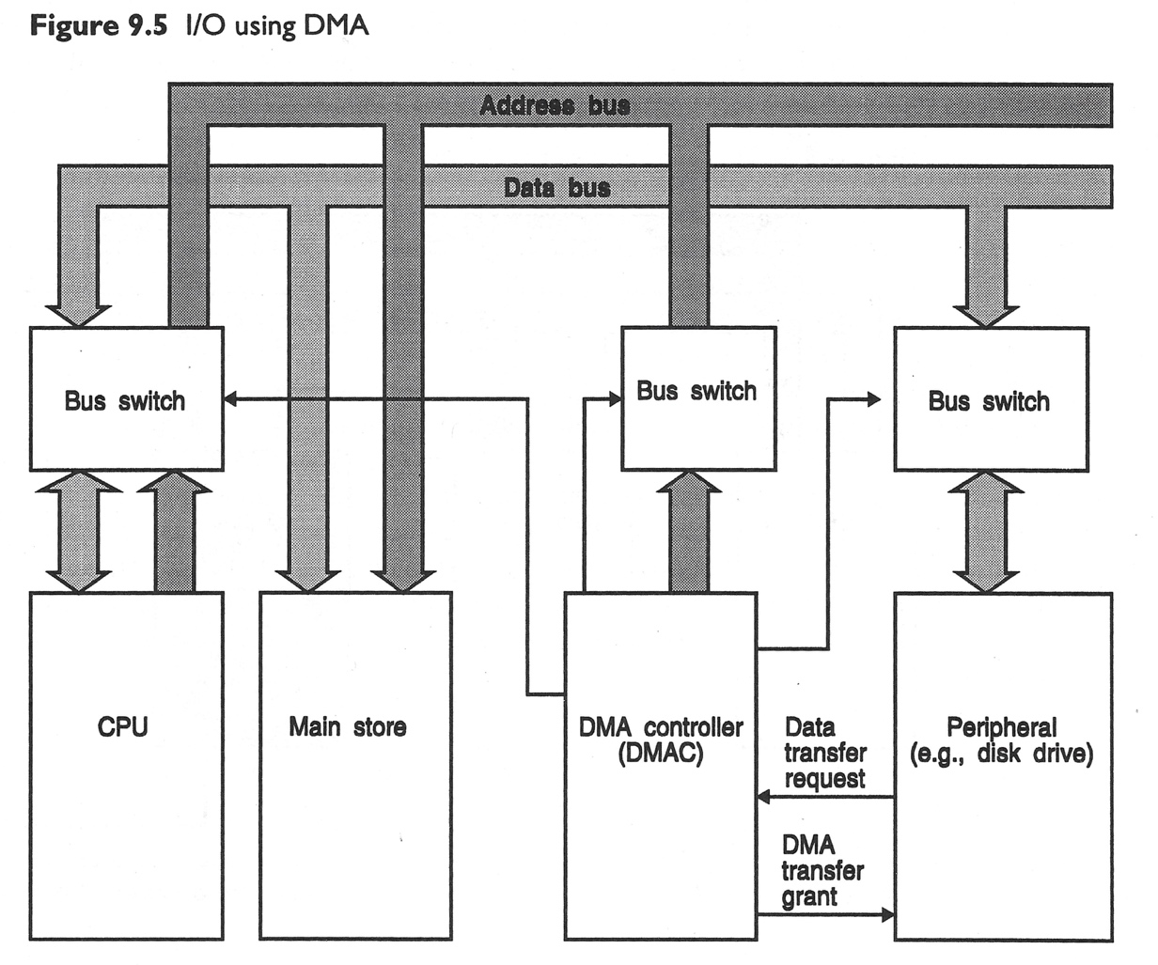
Direct Memory Access (2)
DMA takes care of memory to device or device to memory data transfers.
68K chip family has 68450 DMA Controller (DMAC).
Two transfer modes:
1: Dual address transfers
Read: Read data from memory or device to DMAC internal holding register.
Write: Write data from DMAC internal holding register to memory or device
2: Single address transfers
Read: Transfer data from memory to device
Write: Transfer data from device to memory
Now we got two bus masters:
CPU
DMAC
Clements: p371
→ That’s why we need bus arbitration.

Slide 15
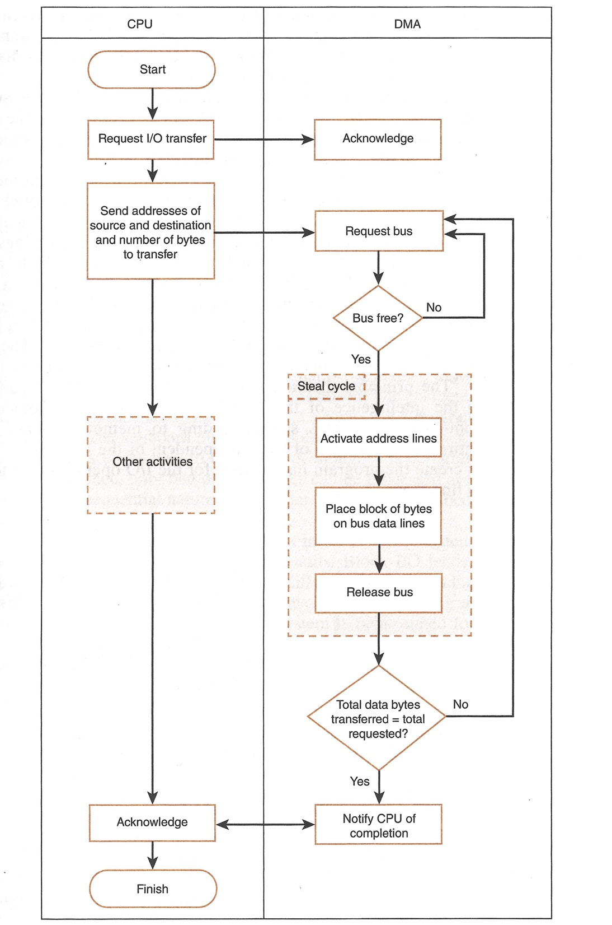
Direct Memory Access (3)
What can CPU perform other activities?
User program A
write(fd, buf, 512);
Request I/O transfer
Resume CPU registers from User stack B
RTE in MC68K, MOV PC, LR in ARM
User program B
Do another computation
Interrupt handling
Resume CPU registers from User stack A
RTE in MC68K, MOV PC, LR in ARM
User program A
Do something right after write( )
Null: p423

Slide 16
Disadvantages of DMA
Overrun errors
While DMAC uses the memory bus in cycle steals or burst transfers, either CPU or DMAC may miss time-critical data
Solution: round robin arbitration
Cache coherency problem
While CPU maintain a copy of data in its cache memory, DMAC may overwrite its original on DRAM.
Solution: cache flush.
CPU
DMA
DMA
DMA
CPU
Time critical data 10 20 30
CPU can’t miss 20.
CPU
DMAC
Cache
$123
$ABC
Bus
$123
DRAM

Slide 17
Summary
Bus arbitration
Review the role of ~AS and ~CE/OE in memory access as well as the role of ~BR and ~BG.
Memory mapped and port mapped I/O
Review the advantages of port mapped I/O
DMA
Review the two advantages brought by DMA.
BTW, we need CPU cache to run CPU in parallel with DMA. Why?
Review the two disadvantages when DMA behaves as a bus master.

